Slide 1
GWAS Catalog
Exploring SNP-trait associations
Presenter: Nguyen Le Duc Minh

Slide 2
Content
Introduction to GWAS catalog and its format
GWAS study and statistics
GWAS data and eligibility criteria
Accessing and navigating through GWAS catalog
Other GWAS databases

Slide 3
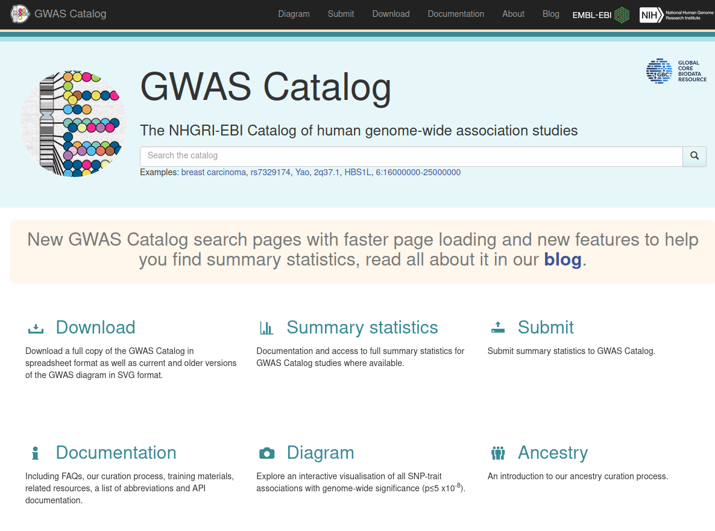

Slide 4
What is the GWAS Catalog ?
The NHGRI-EBI GWAS Catalog is an openly accessible database that contains information about Genome-Wide Association Studies (GWAS) and their outcomes. It was initially established in 2008 by the National Human Genome Research Institute (NHGRI) and has been a joint effort between the EBI (European Bioinformatics Institute) and the NHGRI since 2010.

Slide 5
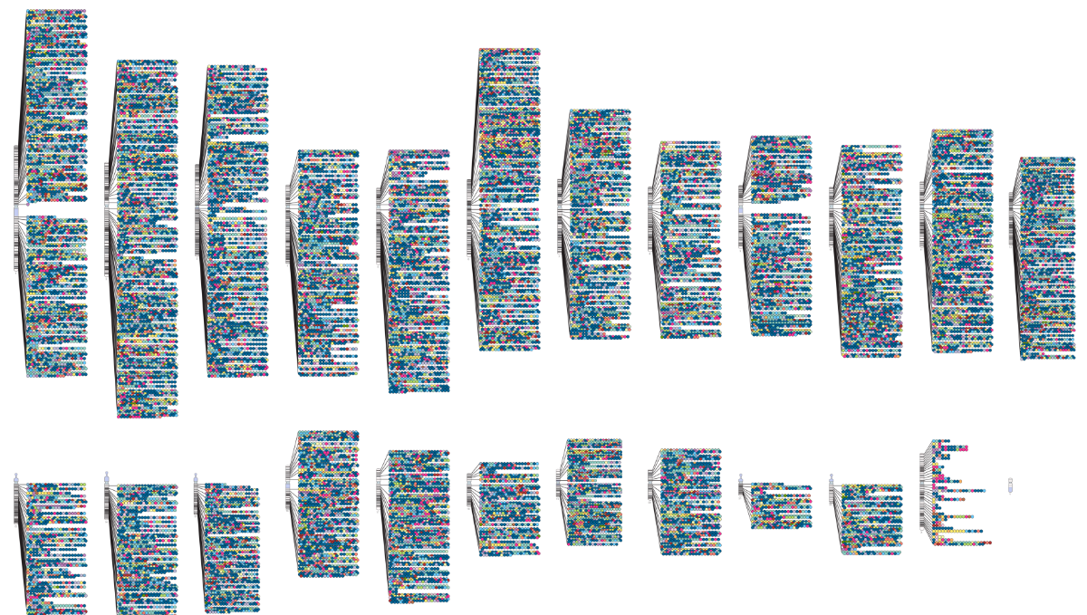
GWAS Diagram
Figure 1 Image showing summary data and karyotype diagram from the GWAS Catalog.

Slide 6
File formats
DATE ADDED TO CATALOG
PUBMEDID
FIRST AUTHOR
DATE
JOURNAL
LINK
STUDY
DISEASE/TRAIT
INITIAL SAMPLE DESCRIPTION
REPLICATION SAMPLE DESCRIPTION
REGION
CHR_ID
CHR_POS
REPORTED GENE(S)
MAPPED GENE(S): gene(s) mapped to the strongest SNP.
UPSTREAM_GENE_ID
DOWNSTREAM_GENE_ID
SNP_GENE_IDS
UPSTREAM_GENE_DISTANCE
20. DOWNSTREAM_GENE_DISTANCE
21. STRONGEST SNP-RISK ALLELE: SNP(s) most strongly associated with trait + risk allele (haplotype)
22. SNPS: strongest SNP (multiple SNPs comprising the haplotype)
23. MERGED
24. SNP_ID_CURRENT
25. CONTEXT
26. INTERGENIC
27. RISK ALLELE FREQUENCY
28. P-VALUE
29. PVALUE_MLOG: -log(p-value)
30. P-VALUE(TEXT)
31. OR or BETA: Reported odds ratio or beta-coefficient associated with strongest SNP risk allele
32. 95% CI (TEXT)
32. PLATFORM (SNPS PASSING QC)
33. CNV
34. ASSOCIATION COUNT
35. MAPPED_TRAIT
36. MAPPED_TRAIT_URI
37. STUDY ACCESSION
38. GENOTYPING_TECHNOLOGY
https://www.ebi.ac.uk/gwas/docs/fileheaders#_file_headers_for_catalog_version_1_0_1
Notes:
The effect size is commonly measured using statistical metrics such as odds ratio (OR) or beta coefficient. The specific metric used depends on the type of trait being studied (binary or continuous) and the analytical method employed.
For binary traits (e.g., presence or absence of a disease), the odds ratio (OR) is often used as a measure of effect size. The odds ratio represents the likelihood of having the trait or disease given the presence of a specific allele or genotype, compared to the likelihood in the absence of that allele or genotype.
For continuous traits (e.g., height, blood pressure), the effect size is typically measured using beta coefficients or regression coefficients. These coefficients estimate the change in the trait value associated with each additional copy of the risk allele.

Slide 7
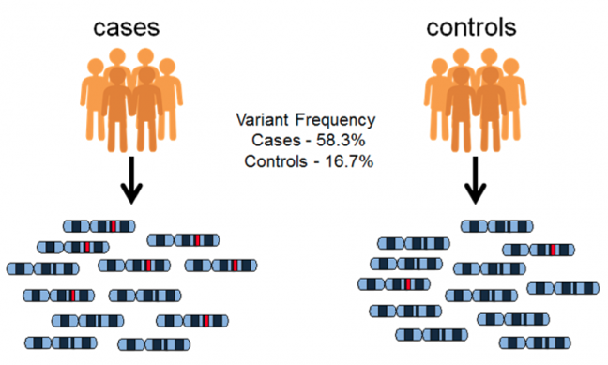
Genome wide association studies (GWAS)
Genome wide association studies (GWAS) are hypothesis-free methods for identifying associations between genetic regions (loci) and traits (including diseases).
Figure 2 Diagram to show typical allele distribution which GWAS seek to identify

Slide 8
GWAS study
In a typical GWAS study, data is gathered from a group of individuals who have a common trait (like a disease) and from individuals who do not have the trait.
The study aims to identify common genetic variations across the entire genome. Variants that are more commonly found in the cases (individuals with the trait) compared to the controls (individuals without the trait) or variants in close proximity to disease-associated variants are considered potentially linked to the trait.
Statistical analysis is performed to determine the likelihood of a variant being associated with the trait.

Slide 9
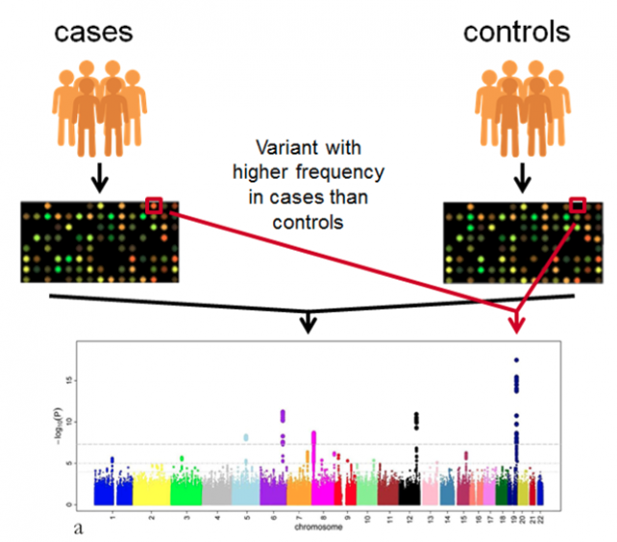
GWAS: array-based method

Slide 10
GWAS statistics
P-value and p-value adjustment are used to indicate the significance of the difference in frequency of the allele (SNPs) examined between cases and controls - the probability that the allele is likely to be associated with the trait.
The Manhattan plot in GWAS displays the strength of association between an allele and a trait by representing the negative logarithm of the p-value against the genomic position. It provides a visual representation of the probability that the allele is linked to the trait, with higher values indicating stronger associations.

Slide 11
The importance of GWAS Catalog
Investigating links between genotype and phenotype - an effective method of identifying association between chromosomal regions (loci) and traits.
Identifying loci associated with complex multifactorial diseases and is able to detect relatively small genetic effects.
The necessary of storing GWAS studies and associations data for scientific community.
https://www.ebi.ac.uk/

Slide 12
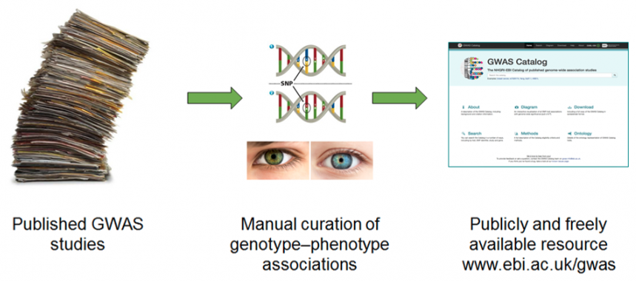
The origin of GWAS data
https://www.ebi.ac.uk/

Slide 13
Eligibility Criteria
Genome wide array or sequencing-based genotyping and analysis of 100,000+ pre-QC SNPs selected to tag variation across the genome.
GWAS data from published studies which are incorporated into new GWAS analyses are eligible.
Arrays include sufficient genome-wide coverage.
For each of these studies, variant-trait associations are included if:
P-value < 1.0 x 10⁻⁵ in the overall (initial GWAS + replication) population
The most significant variant from each independent locus is extracted
https://www.ebi.ac.uk/gwas/docs/methods/criteria

Slide 14
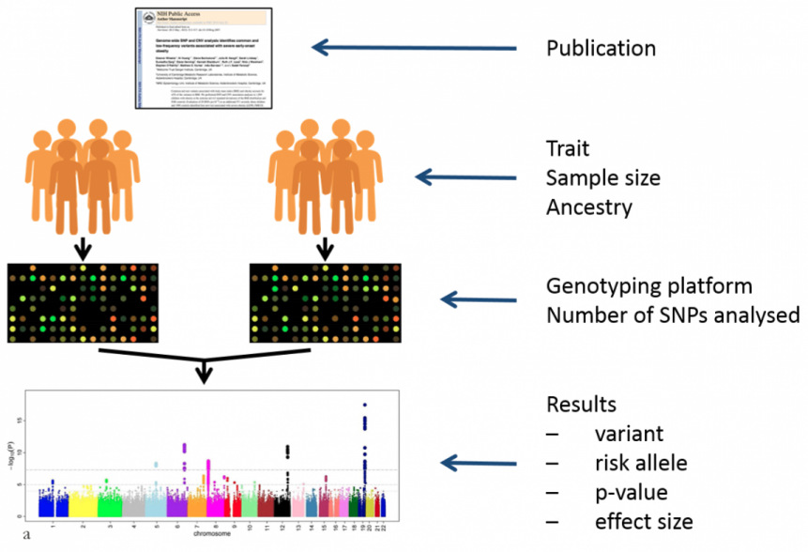
GWAS Catalog: Types of data

Slide 15
Accessing and navigating the GWAS Catalog
Search interface on “https://www.ebi.ac.uk/gwas/” website.
Downloading the entire catalog.
Interactive karyotype diagram “https://www.ebi.ac.uk/gwas/diagram”
Programmatic access via ebi ‘s RESTful API.

Slide 16
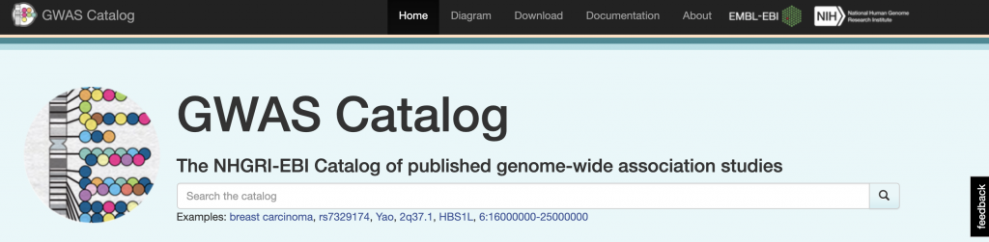
Searching the GWAS Catalog
a trait or its synonym (traits are ontology indexed)
a variant e.g. rsID
a gene
a genomic location/region
publication details i.e. title, author or PubMed ID
https://www.ebi.ac.uk/gwas/search

Slide 17
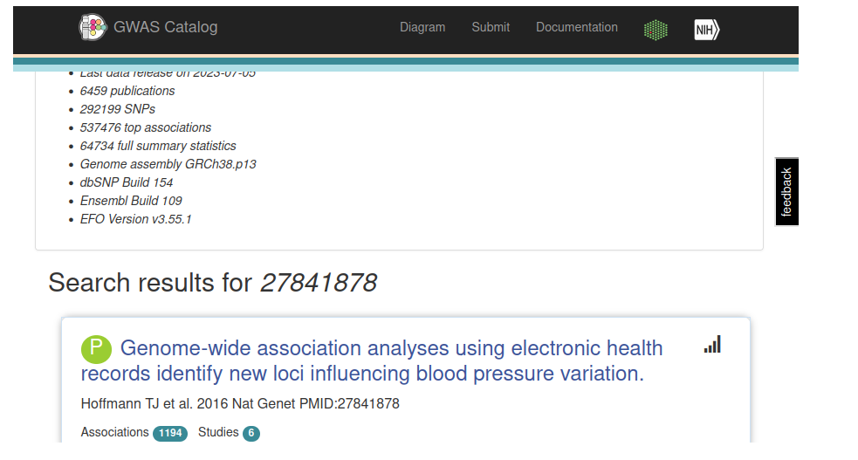
The Publication page
To access the Catalog entry for a specific publication, the best search term to use is the PubMed ID.

Slide 18
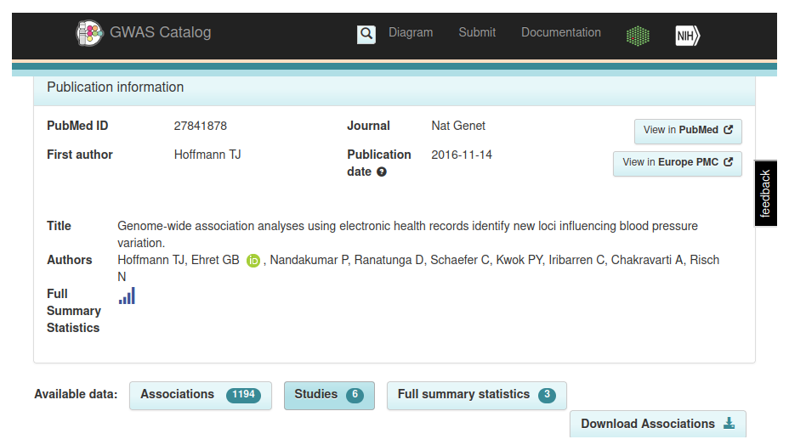
The Study page (1)
Where a publication includes more than one GWAS, each separate GWAS is included as a separate Study.

Slide 19
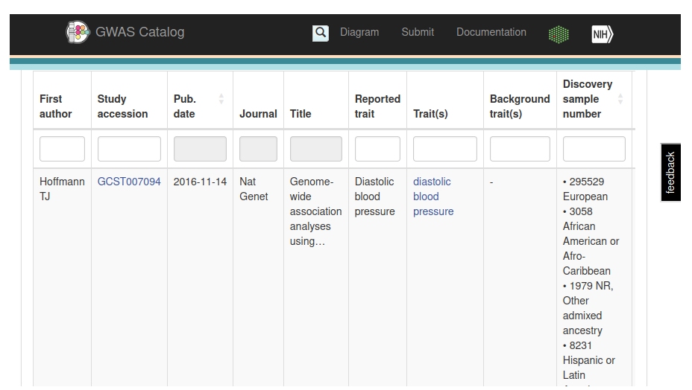
The Study page (2)

Slide 20
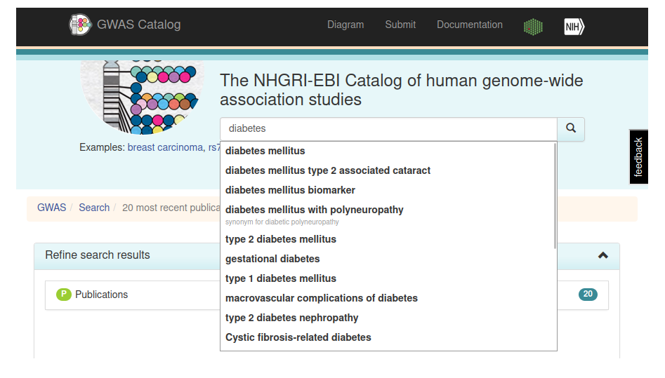
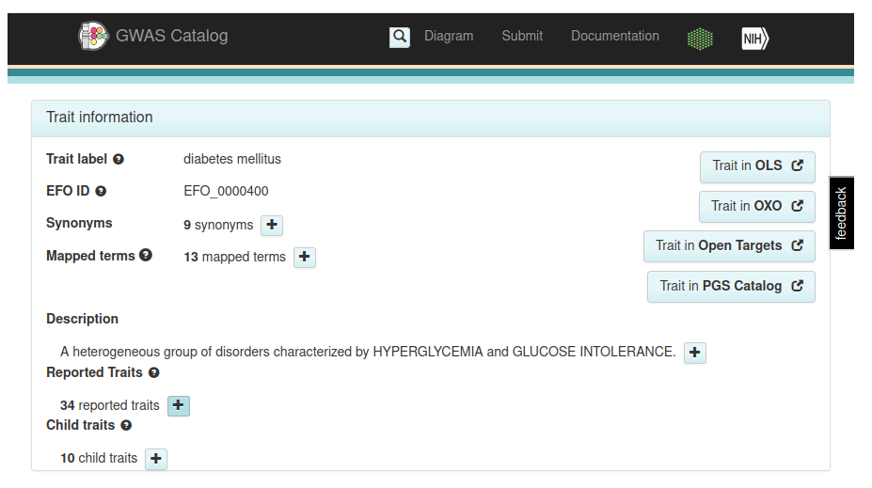
The Trait page (1)
“Which variants have been associated with my trait?”
Searching for the trait in the main search bar. Auto-suggest terms (and synonyms) will be shown from the Catalog.
These terms come from the Experimental Factor Ontology (EFO) - to make it easier to search and compare between studies.

Slide 21
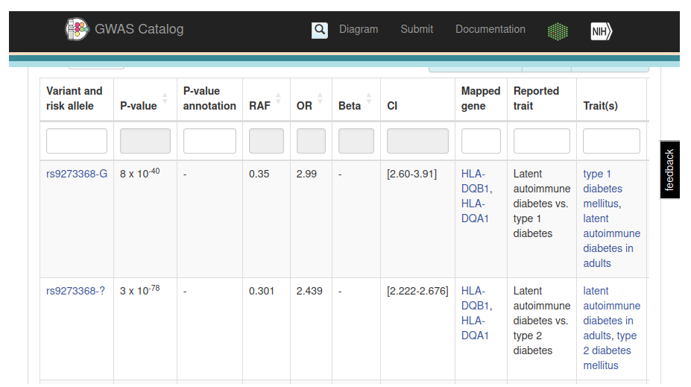
The Trait page (2)
Notes:
Associations table, which summarises all the associations mapped to this trait in the GWAS Catalog, and below that, the Studies table which lists all the studies mapped to this trait, together with their sample details.

Slide 22
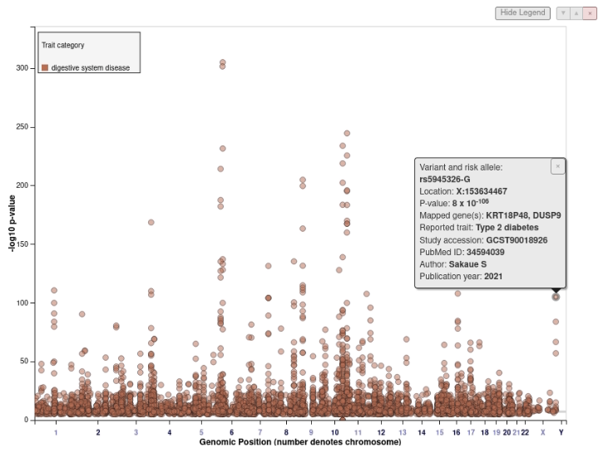
The associations variants mapped to this trait in GWAS Catalog

Slide 23
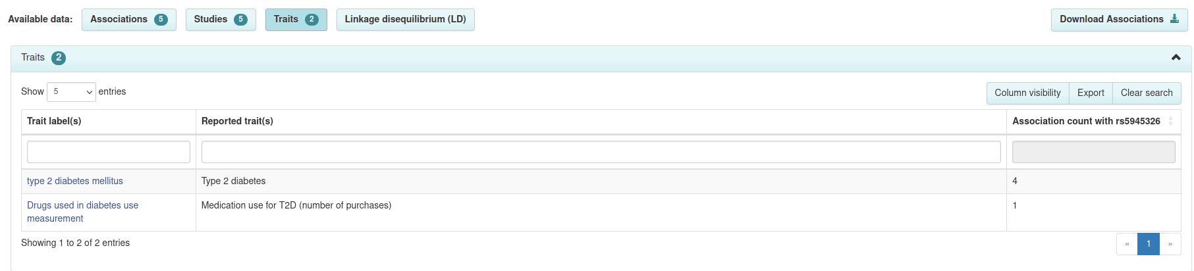
The Variant page: Trait table
“What other associations have been discovered for my variant of interest?”
Trait table
Notes:
There are two unique features on the Variant page.
Trait table
LD plot

Slide 24
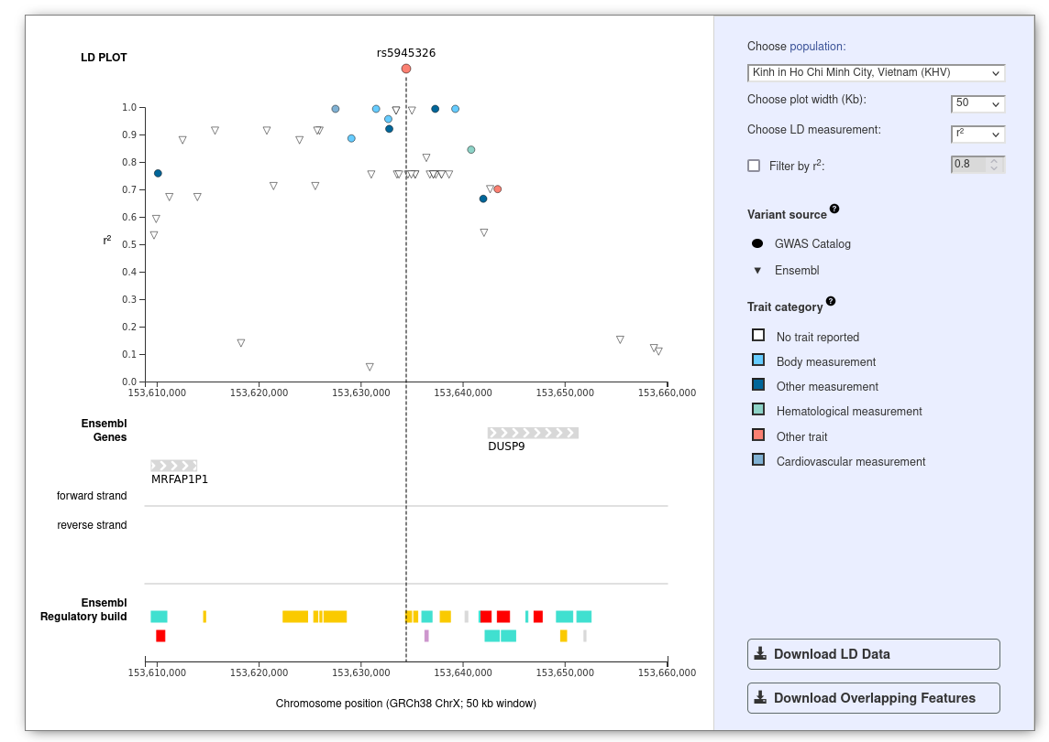
The Variant page: Linkage disequilibrium (LD)

Slide 25
Additional data in the GWAS Catalog
The Catalog also contains additional data:
Only the most significant association (<1×10⁻⁵) from each locus is eligible for inclusion in the curated Catalog.
However, GWAS Catalog also provides full summary statistics files (association statistics for all variants analysed in a GWAS) for any study with available files.

Slide 26
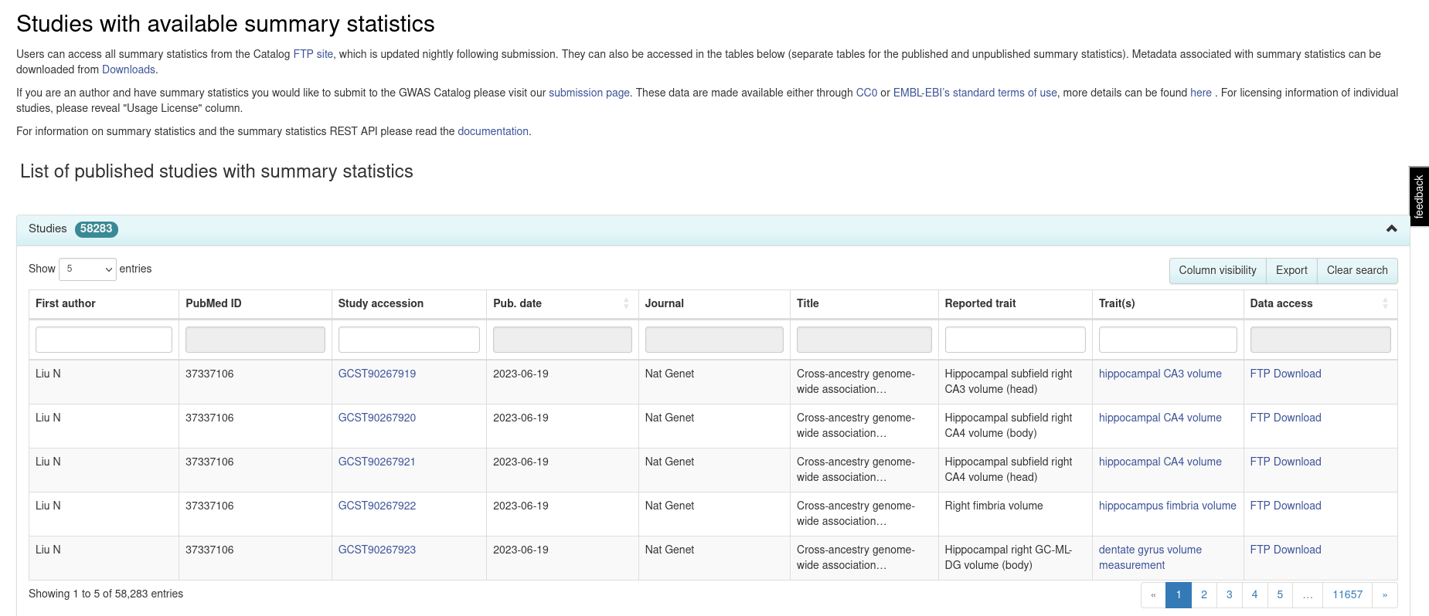
Summary statistics

Slide 27
How to get data from the GWAS Catalog
Once having completed a search, one can obtain the results in various formats:
A visual display on the webpage.
A .csv file of each individual results table that can be downloaded by selecting the export icon, and then imported into Excel.
A large .tsv file of the entire Catalog via downloads page
One can also access ebi’s GWAS Catalog karyotype diagram, which allows users to explore a visualisation of the data across the human chromosomes
One can download summary statistics files from individual studies or the summary statistics page
Accessing the data programmatically via API

Slide 28

Summary
The NHGRI-EBI GWAS Catalog is an openly accessible database that contains information about Genome-Wide Association Studies (GWAS) and their outcomes.
It serves as a valuable resource for identifying genetic variants linked to specific traits and exploring associations between genomic regions and traits.
User can access the catalog by conducting searches on the website or by downloading the entire catalog as a .tsv file.
In addition, the catalog offers summary statistics files that provide comprehensive p-value sets for the entire GWAS, allowing for more in-depth analyses.

Slide 29
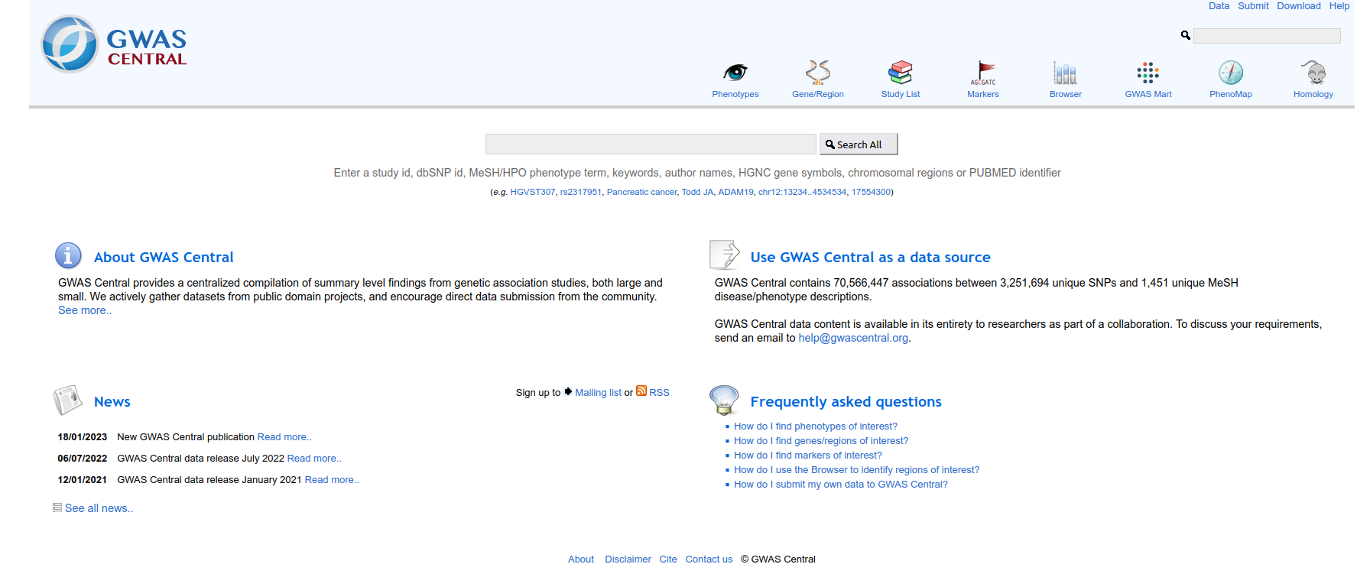
GWAS Central
https://www.gwascentral.org/

Slide 30
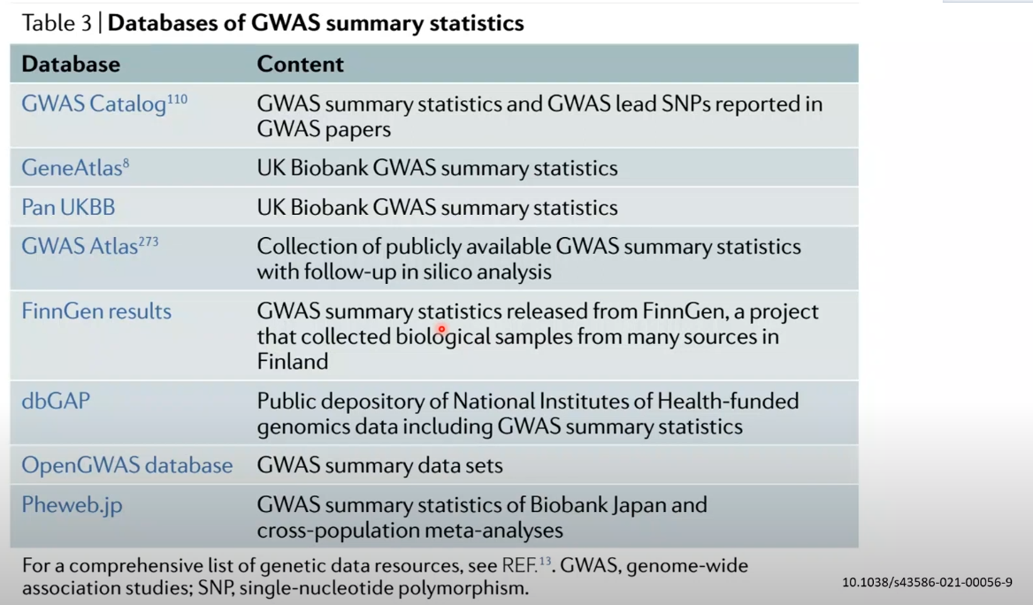

Slide 31


